Slide 1
Udacity Connect Session
March 3, 2018
Model Evaluation and Validation
Part Two
github.com/zkhundkar/ConnectIntensive

Slide 2
Morning Schedule
10:00 - 10:30 | Housekeeping, Review of Last Session
10:30 - 11:00 | Errors vs Scores and K-fold Cross-Validation
11:00 - 11:45 | Notebook session - Cross-Validation and GridSearch
11:45 - noon | Review of Notebook session
Lunch Speaker - Pourya Ayria
© 2016 Udacity. All rights reserved.

Slide 3
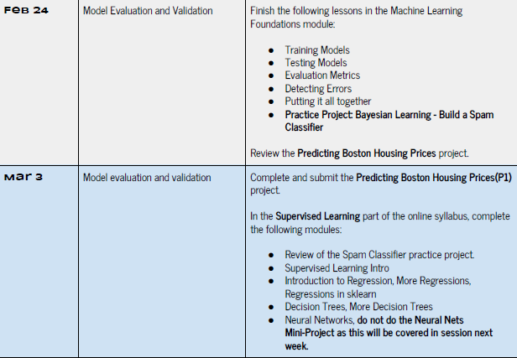

Slide 4
Review of Video Content
ML FOUNDATIONS REVIEW
Detecting Errors
Bias vs Variance
Learning Curves
Complexity Curves
Putting it all together
Hyperparameter tuning - GridSearch, CV
© 2016 Udacity. All rights reserved.

Slide 5
Data
Exploration, pre-processing
Data Types
Three types of data
- numerical, categorical, time series
Variability of Data
Quantifying the variability (good to visualize)
Irreducible error (random or measurement)

Slide 6
Data Variability
Exploration, pre-processing
The goal of fitting a model to any data is to capture and “explain away” the variance in the data due to causes
“Correlation does not imply causality”
Should not try to account for random error
-- leads to “memorization” (overfitting)

Slide 7
Bias vs Variance
Bias
Model is too simple (underfitting)
Variance
Model is “memorizing” the data
Occam’s razor
Choose simpler model if all else equal

Slide 8
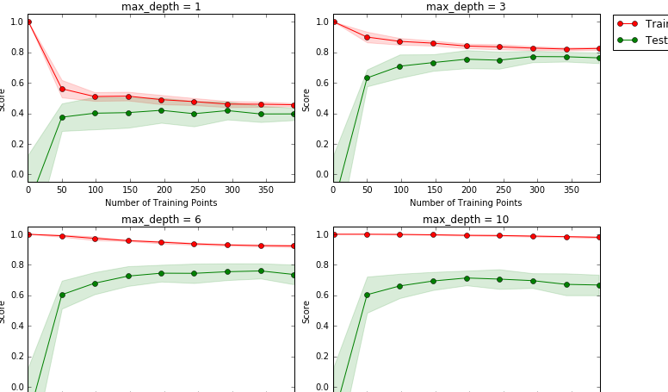

Slide 9
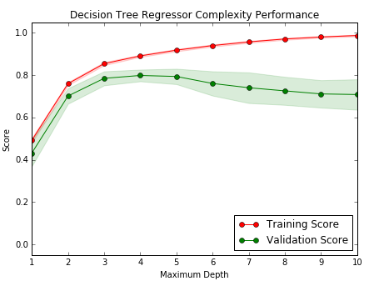
Complexity Curve
MODEL SELECTION OR HYPERPARAMETER TUNING

Slide 10
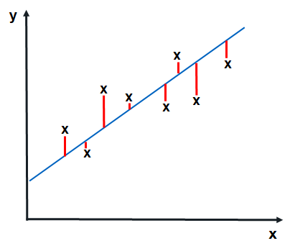
Performance Metric
REGRESSION
random - variance
y = ax + b
Total prediction error
Needs to be positive for both over-estimate and under-estimate
Shouldn’t depend on the number of samples

Slide 11

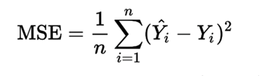
Error Functions
REGRESSION y = ax + b, y = f(x)
mean_absolute_error
mean_squared_error

Slide 12
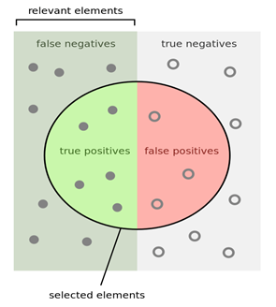
Classification Metrics
ACCURACY sklearn.metrics.accuracy_score
Accuracy Score
(Total correct)/(Total samples)
True Positives/All Samples

Slide 13
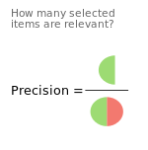
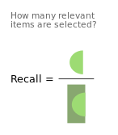
Metrics for Classification
PRECISION vs RECALL
Precision = TP/(TP + FP)
Recall = TP/(TP+FN)

Slide 14
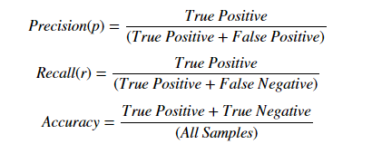
Classification Scores
PRECISION RECALL ACCURACY
p = Precision r = Recall

Slide 15
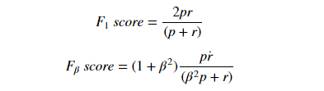
Classification Scores
F -beta score
p = Precision r = Recall

Slide 16
Confusion Matrix
 | Predicted False (negative) | Predicted True (positive)
Ground False | TN | FP
Ground True | FN | TP

Slide 17
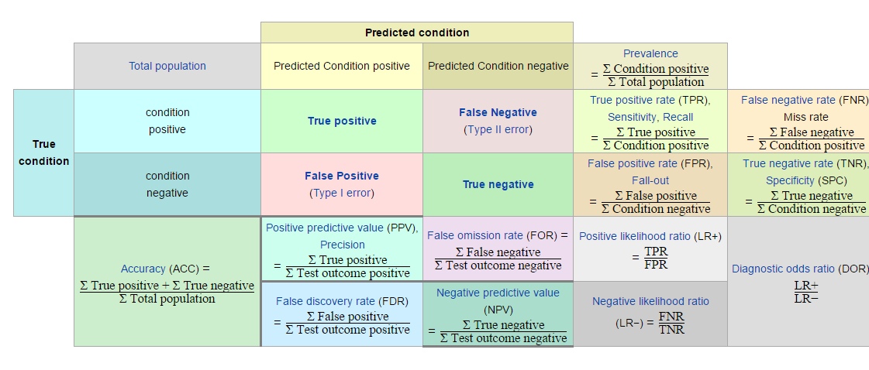
Precision and Recall
https://en.wikipedia.org/wiki/Precision_and_recall

Slide 18
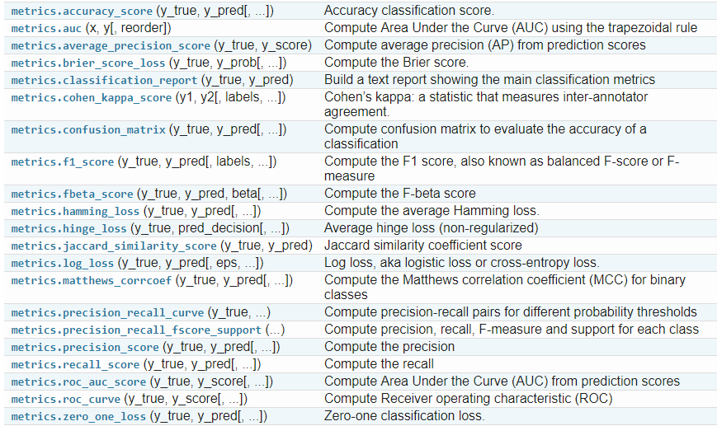
Classification Metrics - sklearn

Slide 19
github.com/zkhundkar/ConnectIntensive/
03 Model Evaluation and CV

Slide 20
Lunch Break

Slide 21
Afternoon Session
1:00 - 1:30 | K-Fold Cross-Validation
1:30 - 2:00 | Notebook Session - continued
2:00 - 2:30 | Introduction to LInear Regression
2:30 - 3:00 | Recap, Lookahead and Feedback
3:00 - 5:00 | Boston Housing Project - (complete)
© 2016 Udacity. All rights reserved.

Slide 22
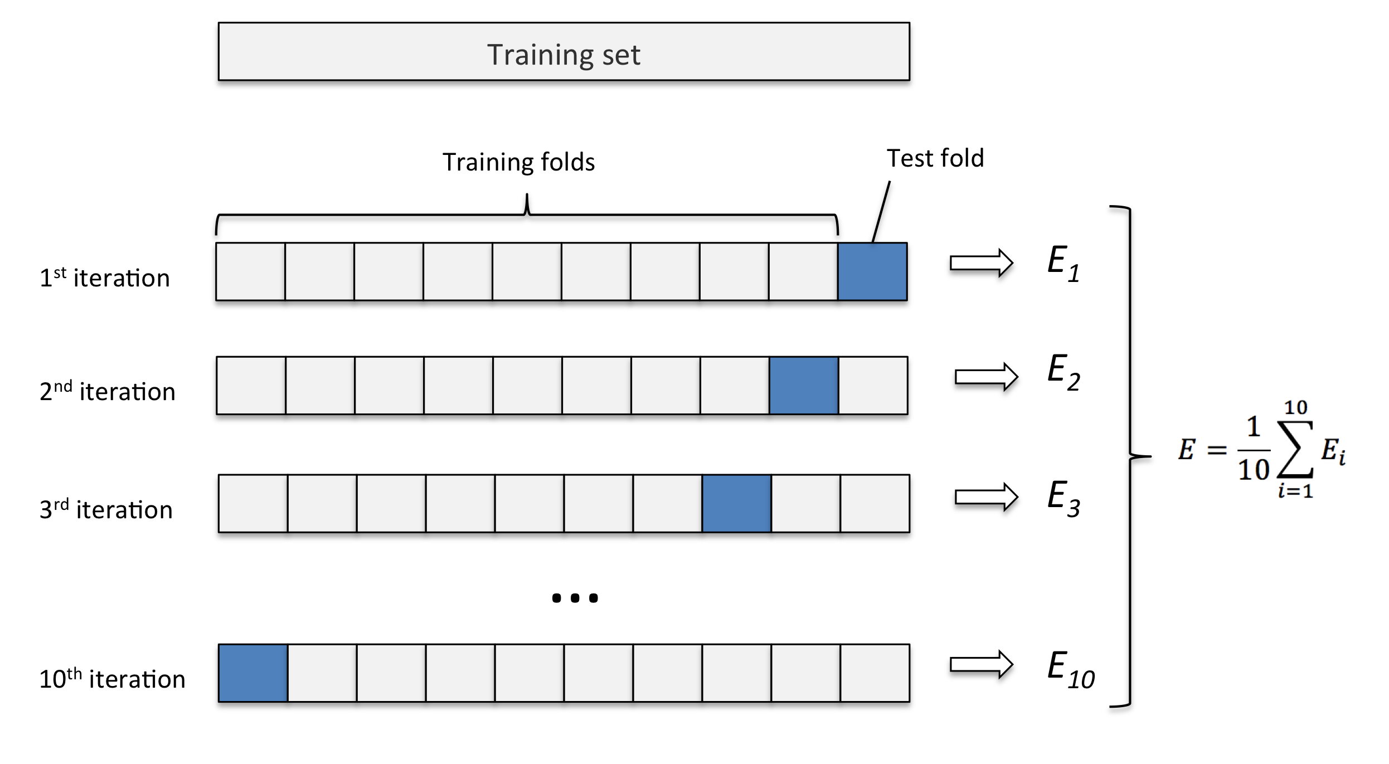
K-Fold Cross-validation

Slide 23
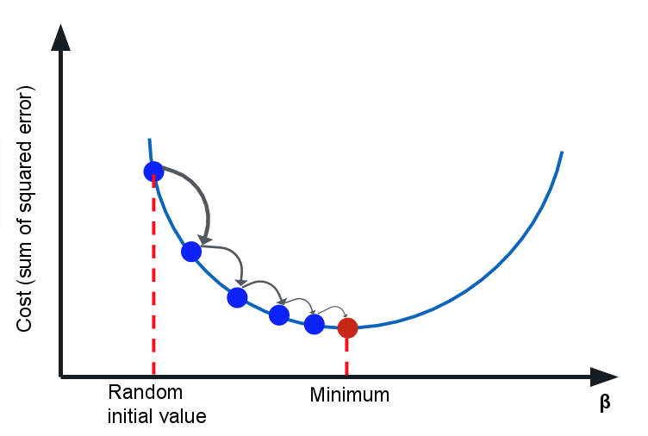
Linear Regression
MINIMIZING A COST FUNCTION
Cost Function C
C needs to be “smooth”
Depends on parameters
Minimize C - often MSE
Calculate direction of steepest descent
Take a step in this direction
Repeat until you get to the bottom

Slide 24
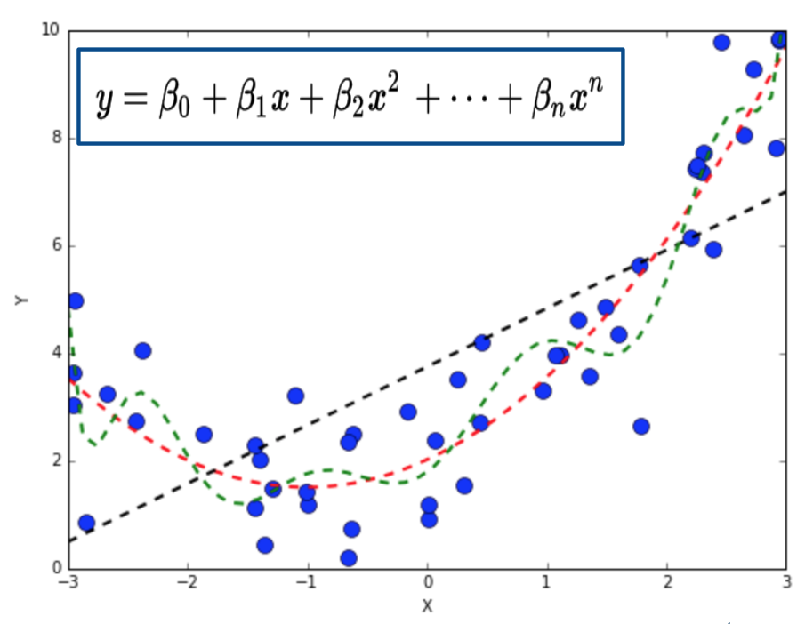
Complex Functions
POLYNOMIAL REGRESSION = LINEAR REGRESSION IN MANY DIMENSIONS
Cost function?
Also MSE
Minimize C - often MSE
Calculate direction of steepest descent
Take a step in this direction
Repeat until you get to the bottom

Slide 25
Prep for next week
Submit/Complete Boston Housing Project
Supervised Learning Unit
Regression, Decision Trees, Neural Nets, SVM

Slide 27

We really need your Feedback!
© 2016 Udacity. All rights reserved.

